Slide 1
Sand Dragon Graveyard
Sunken City of Pazar
Vermin Lord’s colony
Crucian raiders
Marruspawns
Were-crocodiles
Abandoned settlement
Dune hags
Asherati
Veluuthra outpost
Crocosphinx monument
Blue Dragon Graveyard
Sand dragon lair
Oasis of the Mirage Mullah
Porcupine cactus patch
The Asherati Plains
Scale: |--1 mile--|

Slide 2
Sand Dragon Graveyard
10
18
16
17
11
12
13
6
Raptoran city overlooking the valley
15
4
14
Blue Dragon Graveyard
3
7
8
Mountaintop pyramids of the Mirage Mullah
5
X
wagon
Oasis of the Mirage Mullah
9
1
zombies?
The Asherati Plains
Scale: |--1 mile--|
Wind velocity: 10’ – 15’

Slide 3
Icy Towers of Chaos
Mayhem Cliffs overlooking forest
The Way Down
Raptoran Forest
Tundra Plateau
Sand Drakes
Liberation Cliffs overlooking ocean
Veluuthra
battle
Asherati Plateau
Asherati Plains
Borak’s Lair
Tyranny Cliffs overlooking forest
PCs
Vortex Conduit
Mt. Carceri
Sandy Foothills
Saltmarsh
Stockade of Law
Piety Cliffs overlooking ocean
The Straight Path of Good

Slide 4
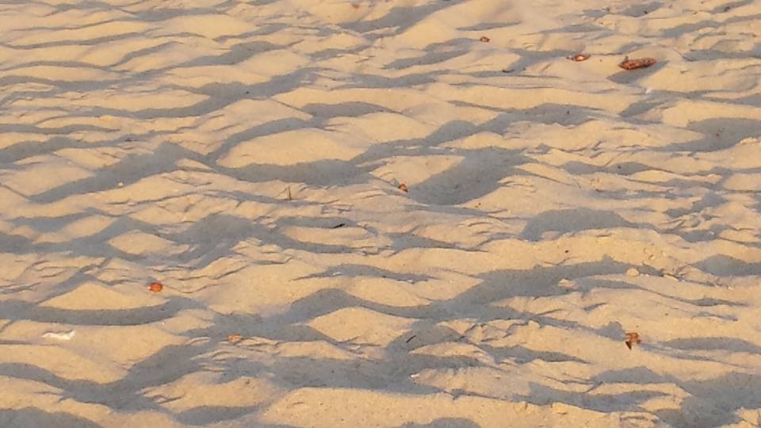

Slide 5
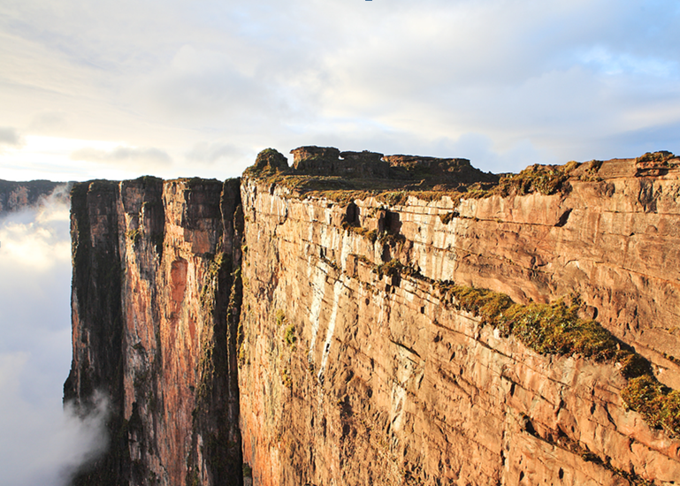
Θ
Perches
Cleric
A
Jsn
P
O
griffon
Jdn
F

Slide 6
You
are
here
Ethereal Conduit
Astral Conduit
Understyx
Understyx

