Slide 1
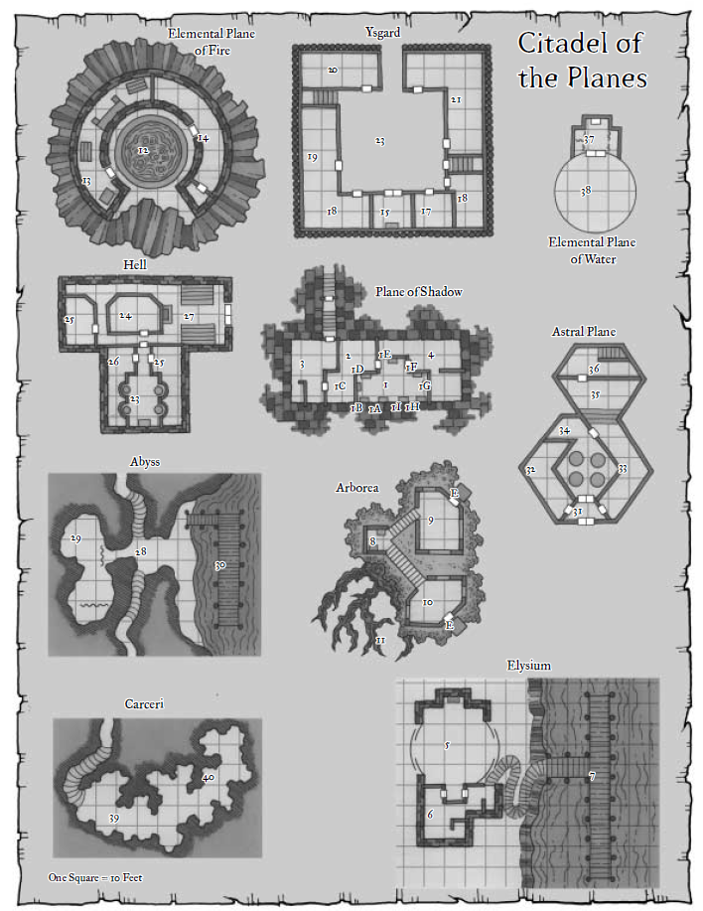
The portals’ positions in the Plane of Shadow map on this slide aren’t consistent with their positions in the Plane of Shadow slide. Use the latter as the definitive source of current ground truth.
The IC explanation for the discrepancy is that the PCs will find this map in the map room in the Ysgard suite, but the map will reflect Parjit’s layout as he had it before the sale of the mansion on the Material Plane. The layout was changed by Kaszüm shortly after his ilk moved in.
To Material
Plane
Citadel
of the
Planes

Slide 2
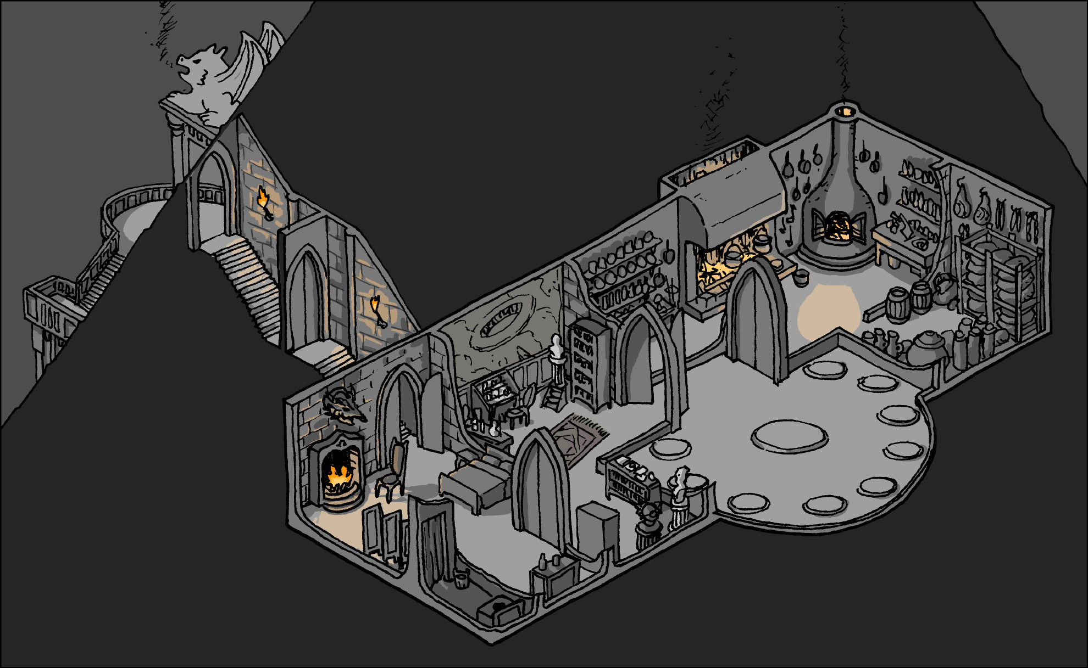
Plane of Shadow
Spiderweb
trap
wedge
L
A
O
Water
Ely
Fire
Arb
Ysg
Hell
Astral
Crc
Abyss

Slide 3
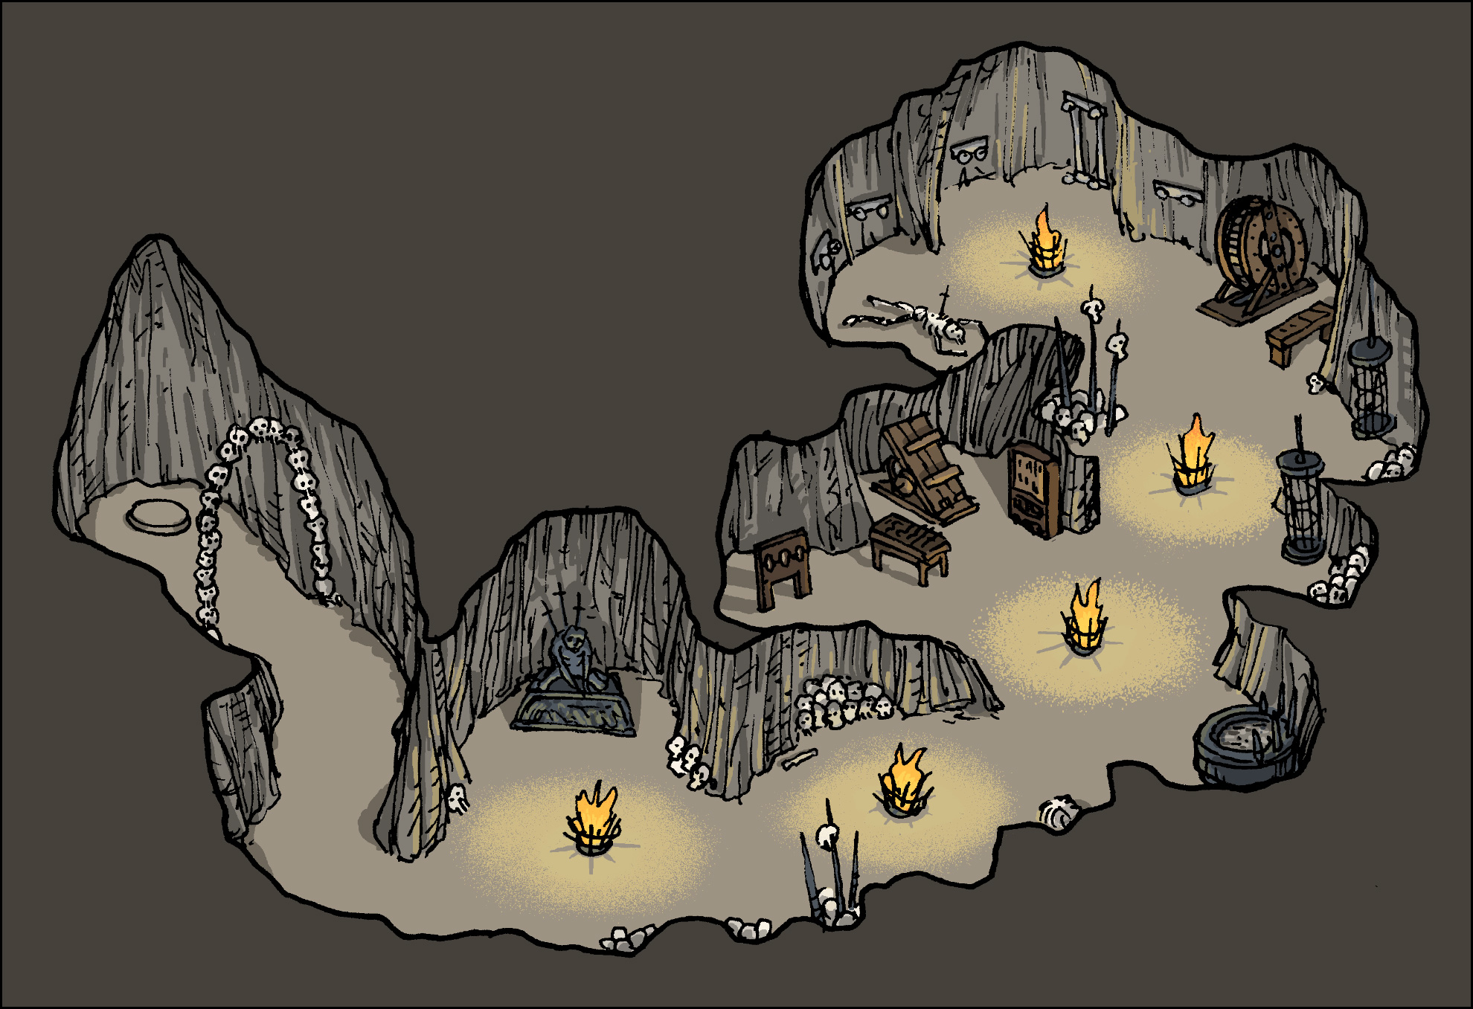
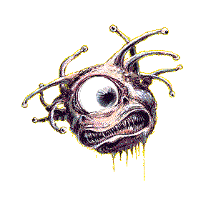
Carceri (Colothys)
Shadow
Plane
Dulkhende
Assorted
Skulls
Shator Skull

Slide 4
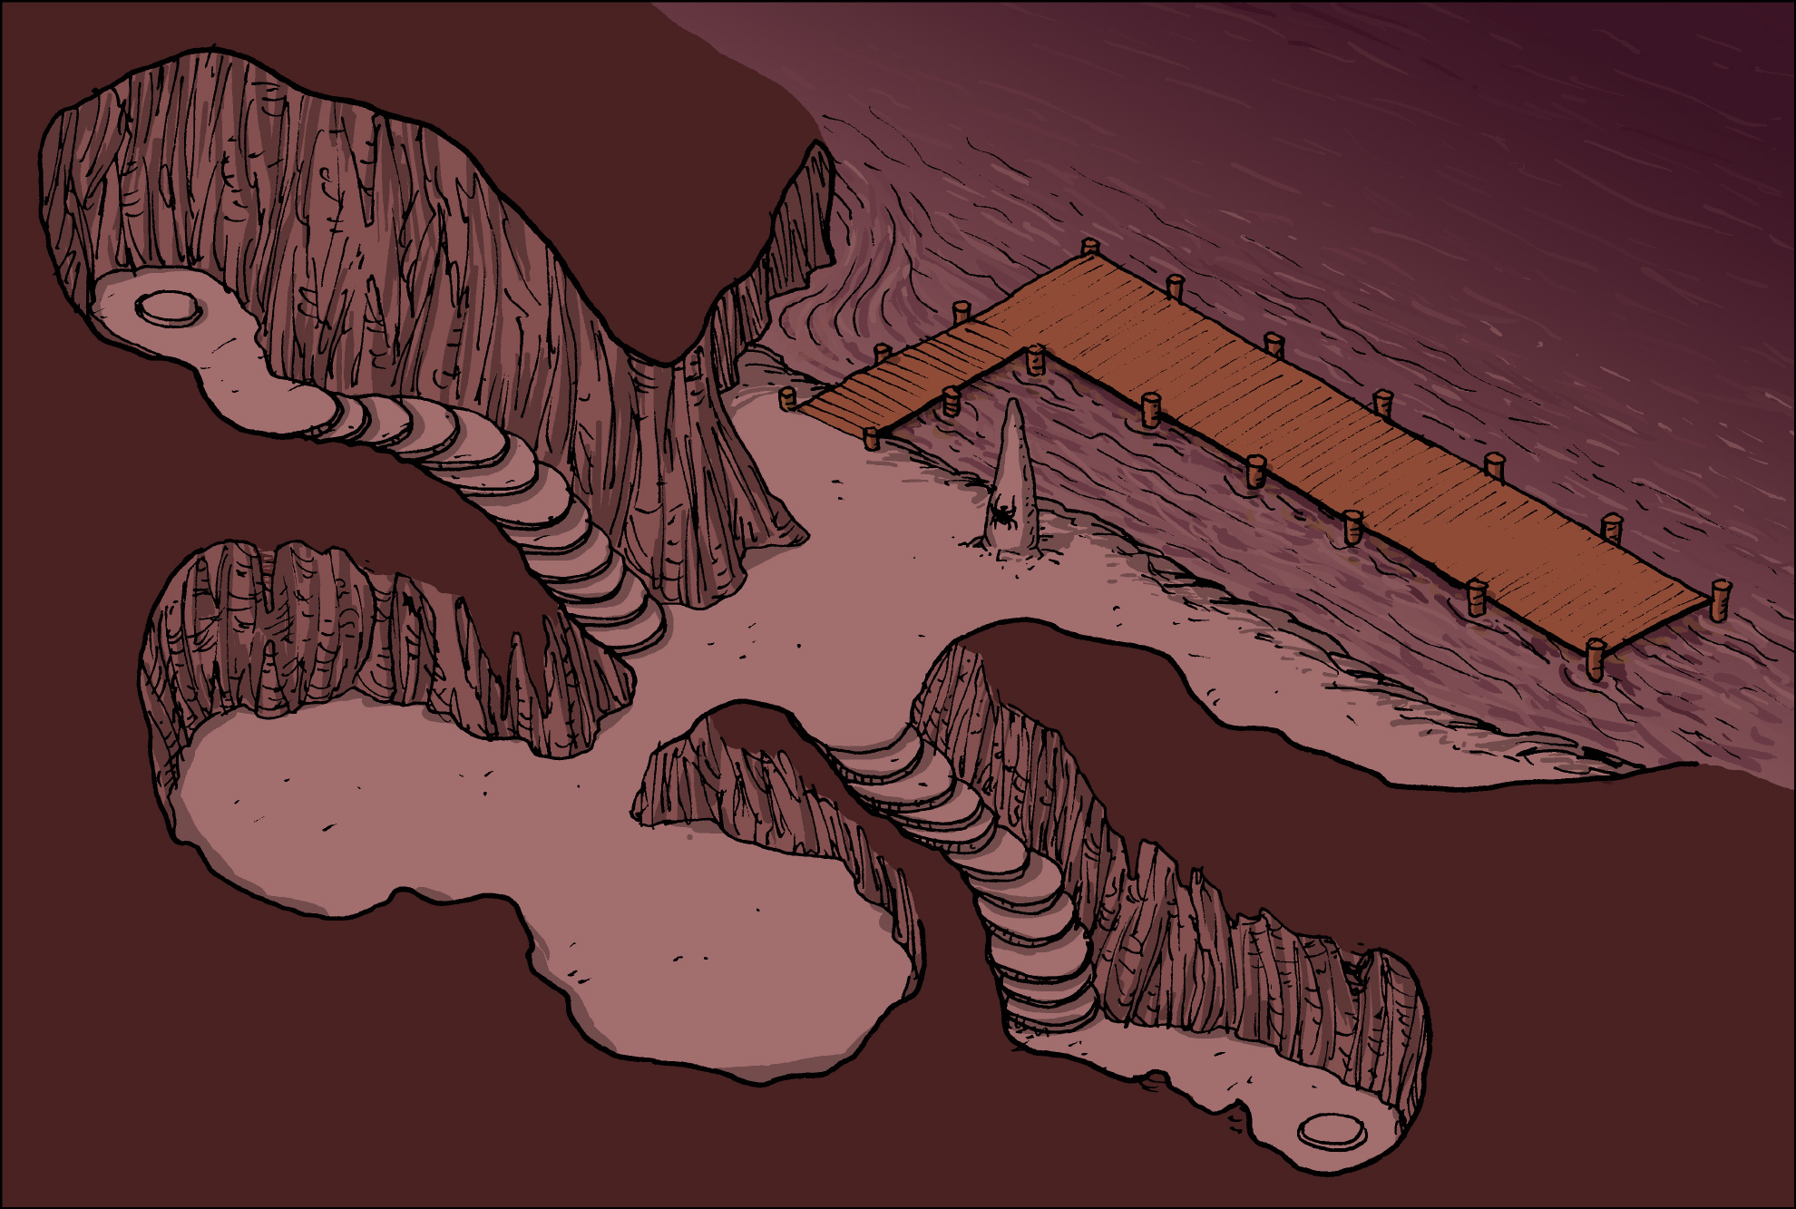
A ship commandeered by a Slaad necromancer with a crew of aquatic abyssal drow ghouls (FF) will pass by if the PCs have been here for more than 5 minutes.
Abyss
Az
To Ysgard
Kr
Velvet
Duncecap
Blg
Jinx
Kafi
Lrl
Footprints
Where’s
the Party?
All of the
Treasure
Karmen got here with the Ysgard crystal, and will have it on her when encountered.
To Shadow
Plane

Slide 5
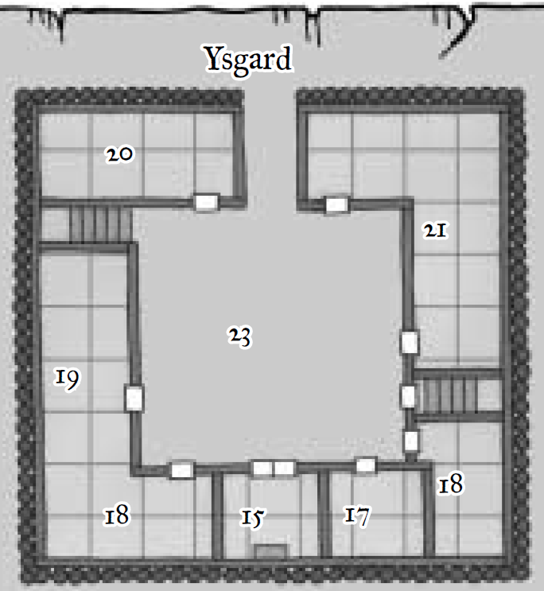
Crystals to Arborea and Ysgard portals are found in Arborea.
To
Arborean
Portal
\
Treasure
Room
Repository
of Provisions
X
This extradimensional space has a smaller grid in the courtyard than in every adjacent room. All squares on this map, regardless of size, represent a 5’ x 5’ area.
To Abyss?
Fingers’
Armor
And
Crystal
A
M
D
F
k
Barracks
L
To Shadow
Plane
Allisa’s
Scimitar
Map
Room
Armory
Hall of the
High Ground
Warden’s
Office

Slide 6
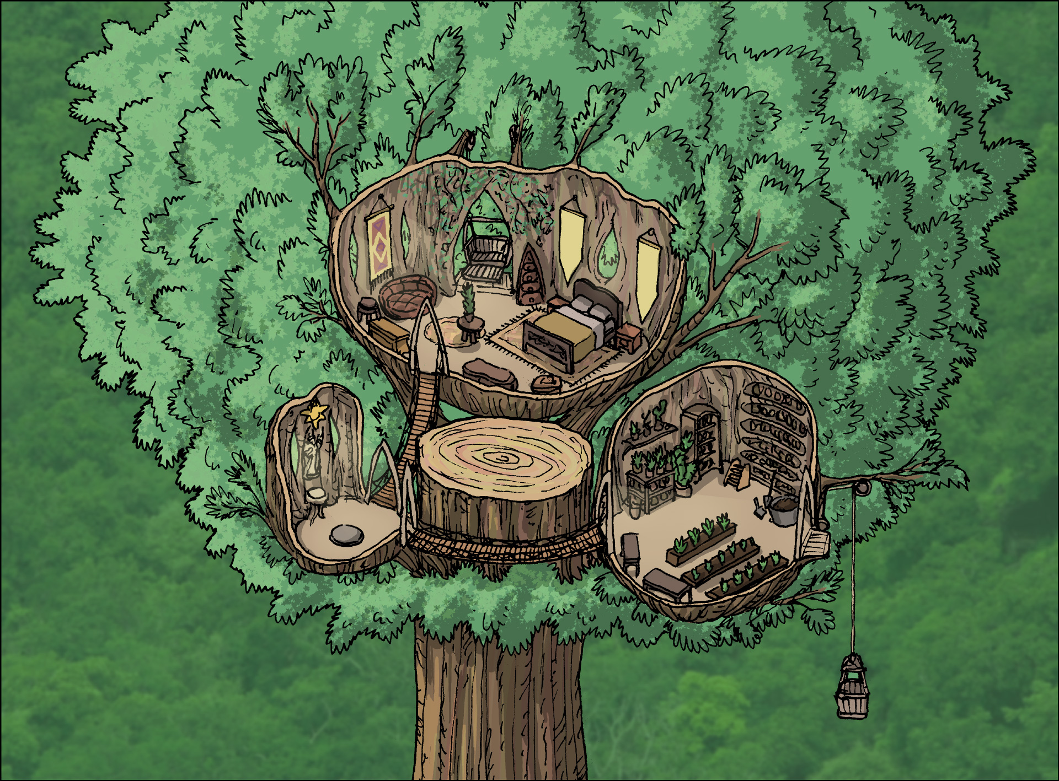
Ecological Note: The greenbound creatures are keeping the Verdant Prince’s forces away from the Arborea Suite. The Verdant Prince has become aware of the hidden tree’s location, and has motives to seize it for himself.
Arborea (Arvandor)
Treetop is 200’ up, and surrounded by umbral banyans, treants, and other properly aligned active plants.
L
A
Oakleaf
Suite
F
Botanist’s
Study
To Shadow
Plane
Both doors in the Entry are locked from the opposite sides.
Greenbound
Cat
Greenbound
Deer

Slide 7
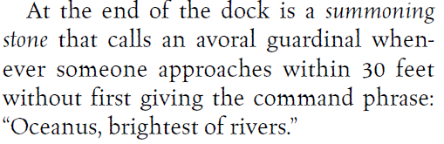
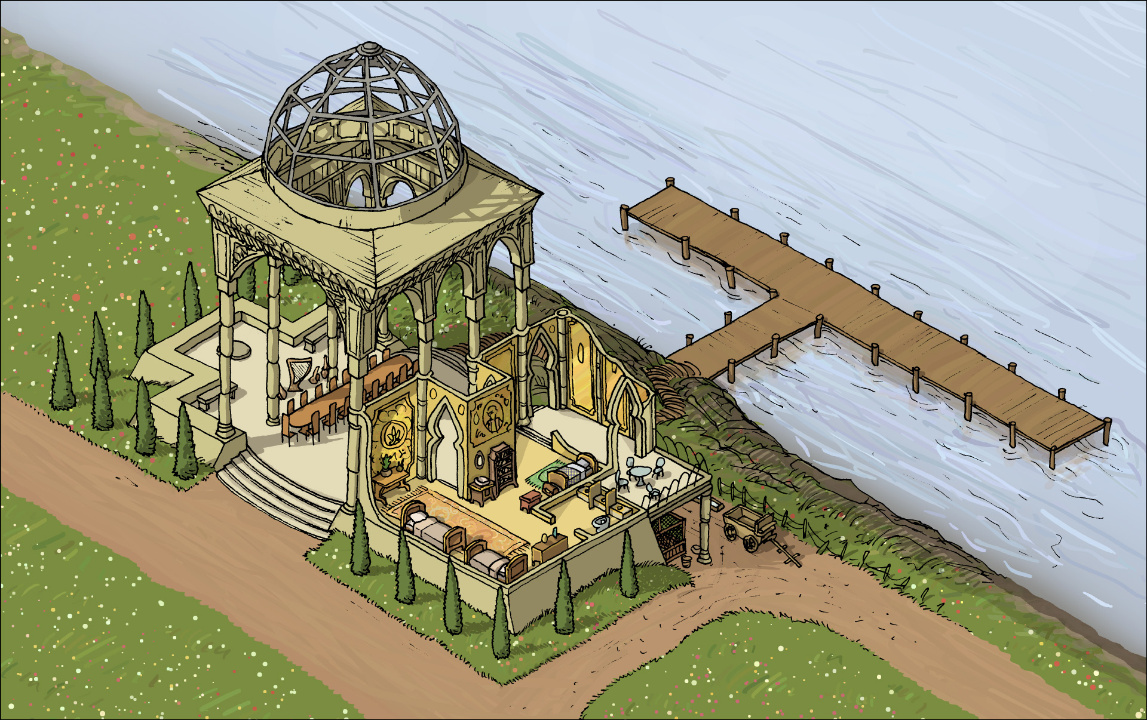
The Acupuncturist carries the Plane of Water crystal with her.
Elysium (Thalasia)
blood?
To Shadow
Plane
V
G
Fa
Gwen’s
Suite
A
L
The belongings of a gnome, or possibly a large halfling, are strewn about in the meadow suite.
P
O
O
N
3G
G

Slide 8
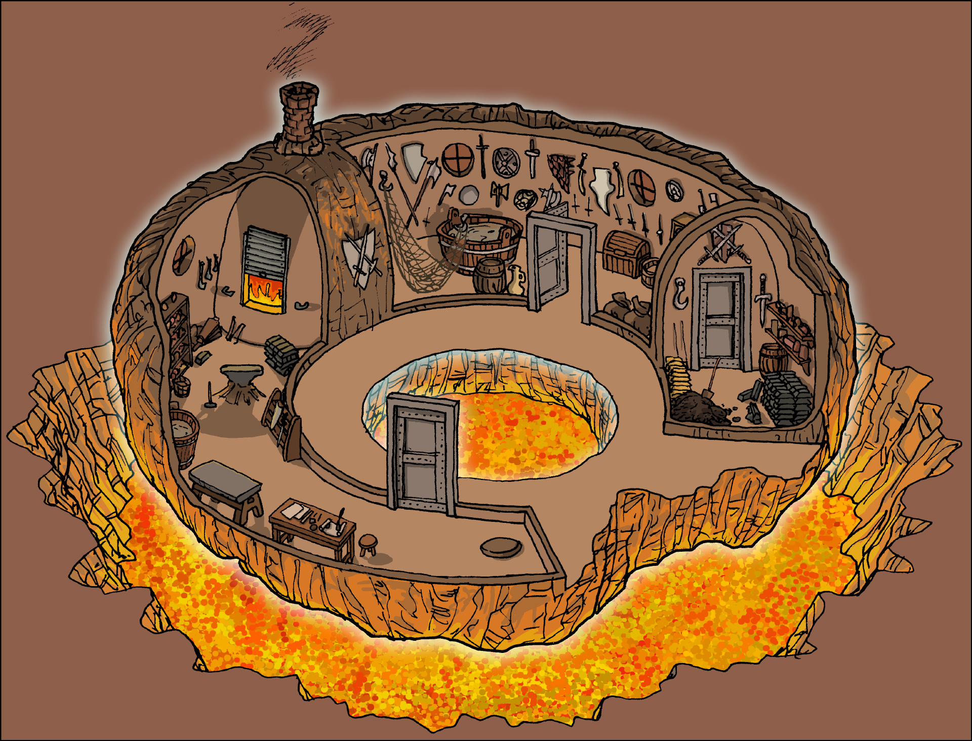

Fosfra and Imola (fire giants)
Ignaçe (efreeti)
Furnaçe (H fire elemental)
Moltar and Magmar (lava mephits)
Moisea (fire hydra)
Plane of Fire
A spare Astral crystal can be found in the Coal-Ember Suite. It’s a replica of the one found in the Plane of Water, which is the original.
Coal-Ember
Suite
Smithy
12 Heads
Encounter
BoC 107
Smithy
A
E
R
L
To Shadow
Plane
S
I
M
I
m₁
§
m₂
F

Slide 9
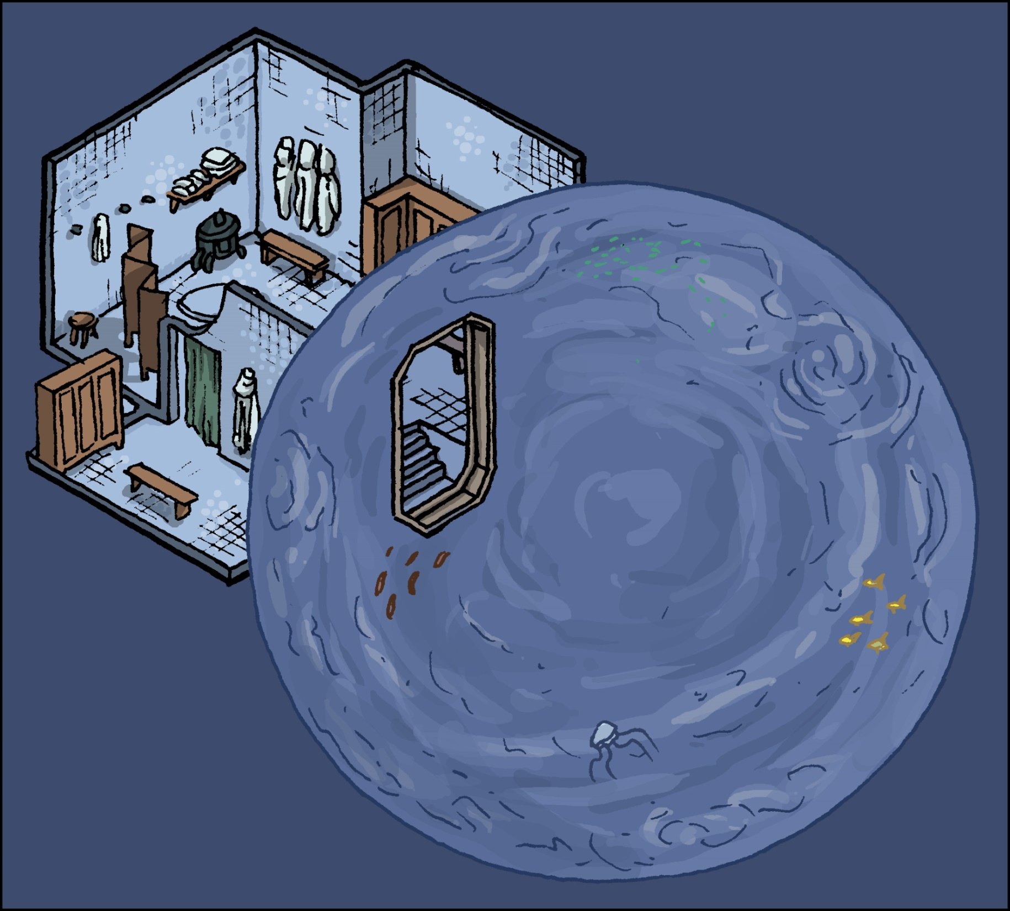
The slave has purposely and obediently swallowed the Astral crystal, and will fight to the death to protect it.
Water
Genasi
Merfolk
Love Slaves
As with he Ysgard Suite, the bubble comprises an extradimensional space about 10’ larger than shown in comparison to the rest of the Suite.
I
A
F
E
L
R
S
Plane of Water
§
To Shadow
Plane
Changing
Rooms
m₁
Positive
Energy
Spout
I
M
m₂

Slide 10
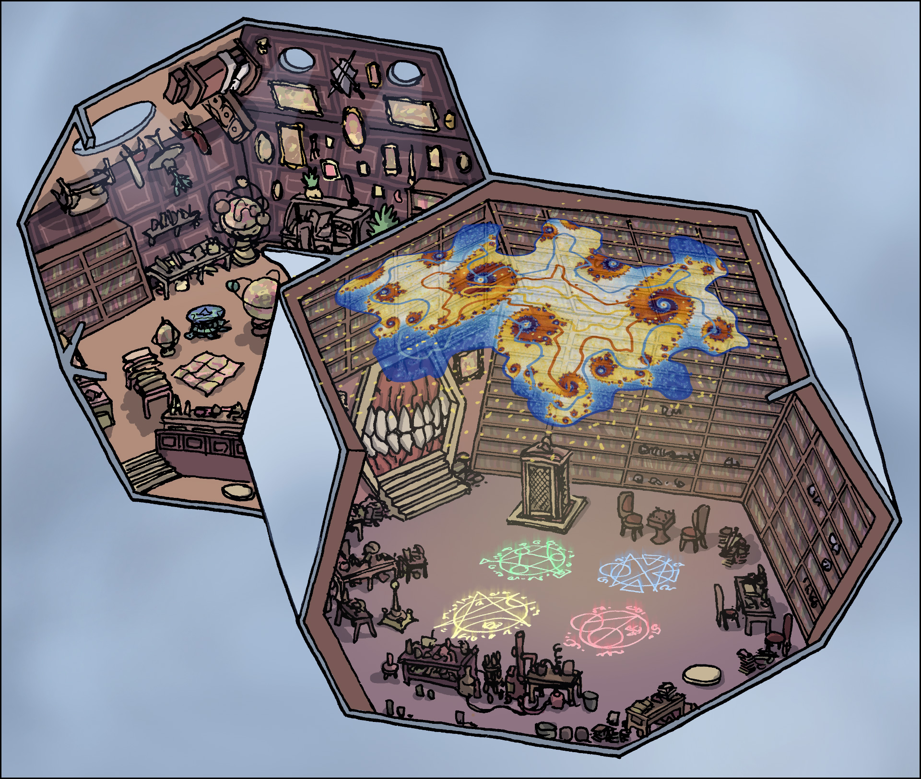
Astral Plane
Heart
Suite
Violet
Library
L
E
Arcanist’s
Study
Grand
Library
A
I
R
Magic
Lab
S
To Shadow
Plane

Slide 11
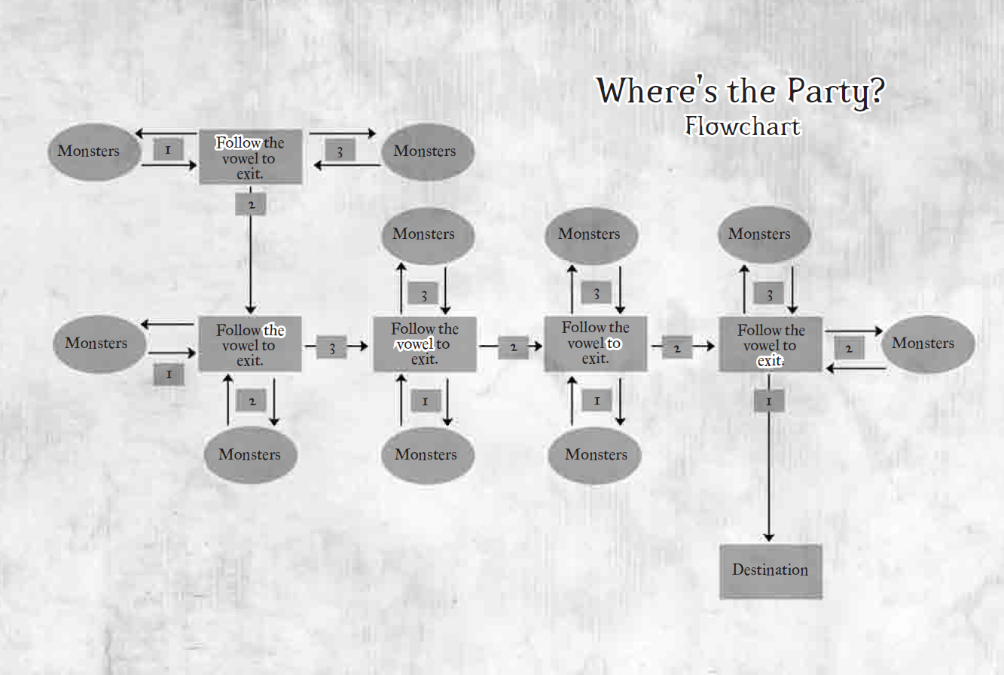

Slide 12
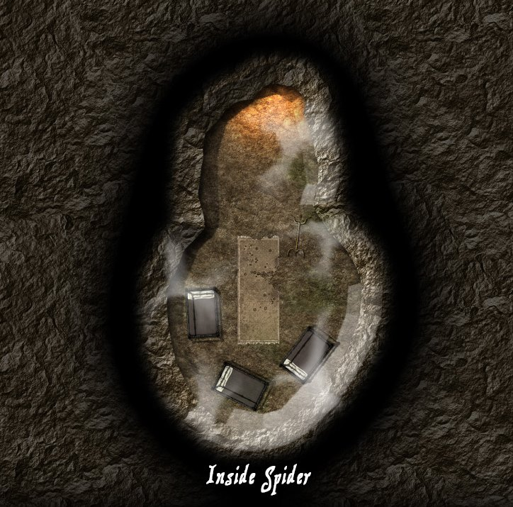


L
ch

Slide 13
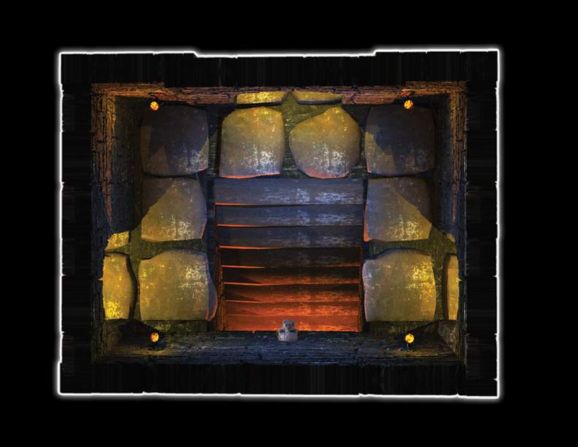
h
h
a
L
h
a

Slide 14
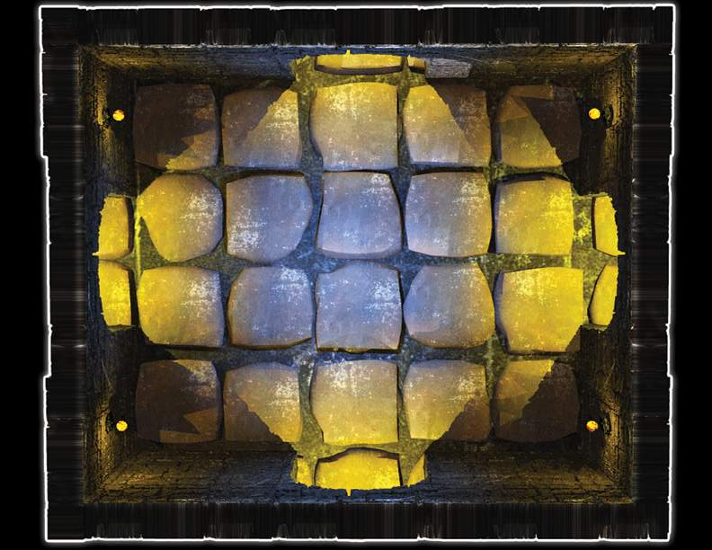
D
L

Slide 15
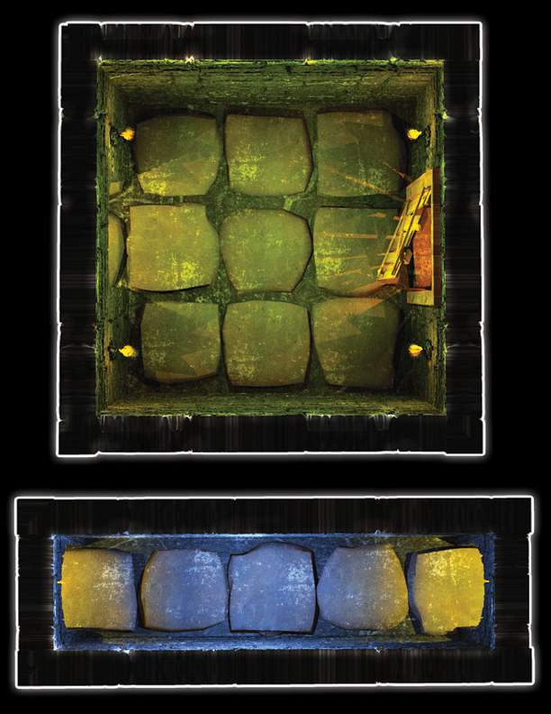

follow the vowel to exit
L

Slide 16
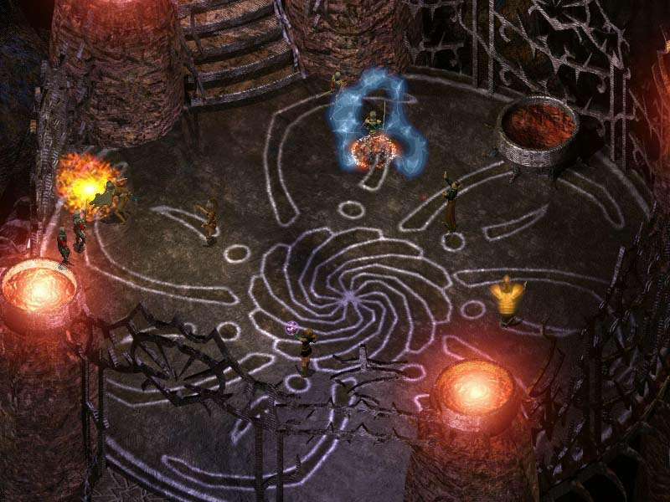
L
3
6
2

Slide 17
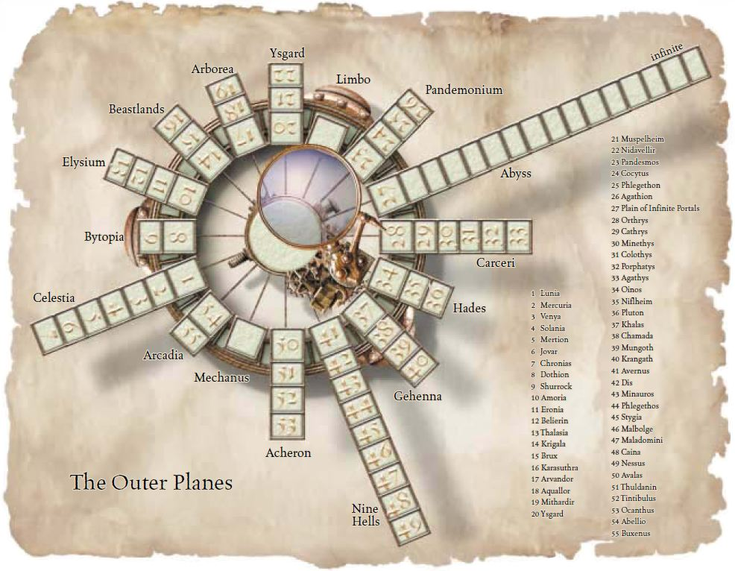
Magenta arrows represent logical progression paths from plane to plane via finding keys and other entry McGuffins.
Turquoise arrows represent a direct path from one plane to another.
Water
Astral
Fire

