Slide 1
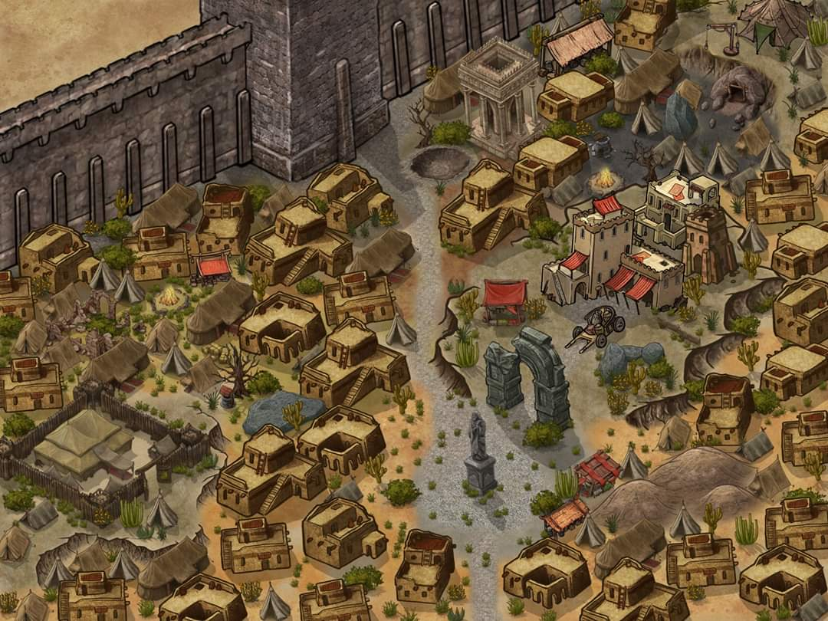
s
T
G₃
Guards
G₄
G₁
G₂

