Slide 1
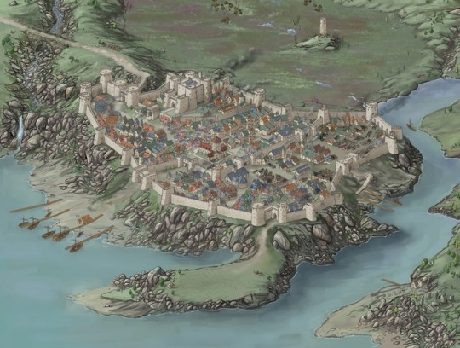
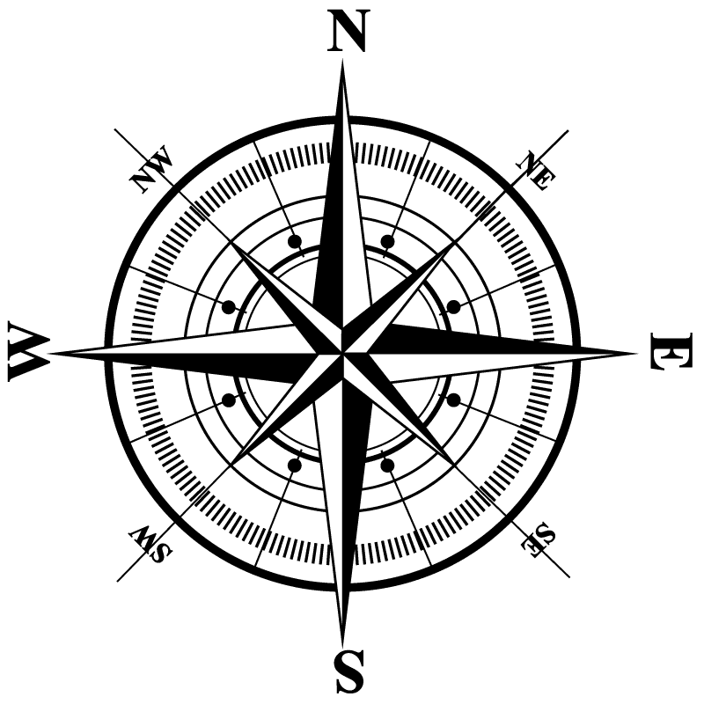
Mintar
Holy
Grove
Halfling
Encampment
Northgate
Baron’s Keep
Westgate
Inns
Shrine to
Mayaheine
Temple
of Tyr
Southspur
Barracks
Temple
of Gond
Bell Tower
Silver Hill
Ford North
West Hill
Fishersgate
Eastgate
Shrine to
Lurue
Chatterstreet
Market

Slide 2
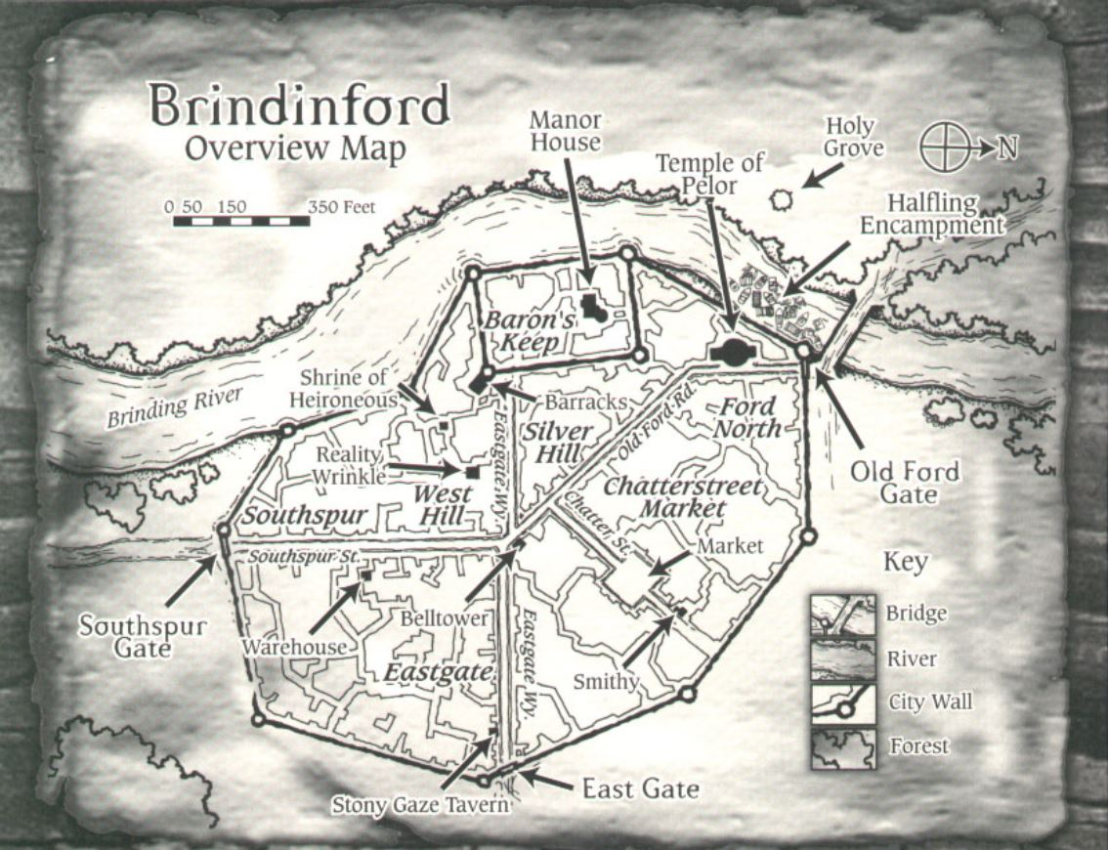
Mintar
false map

Slide 3
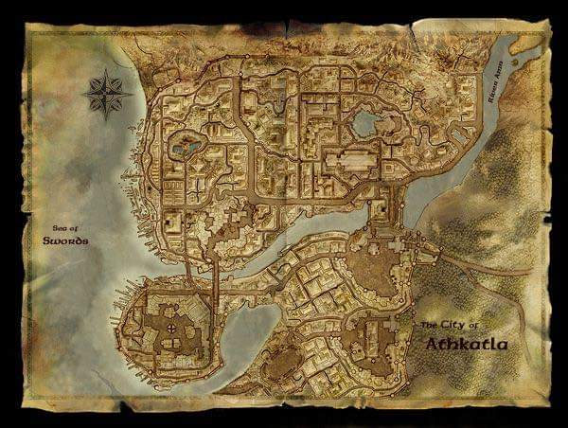
The Thornwash
Lake of
Steam
The Thornwash
Ankhapur

Slide 4
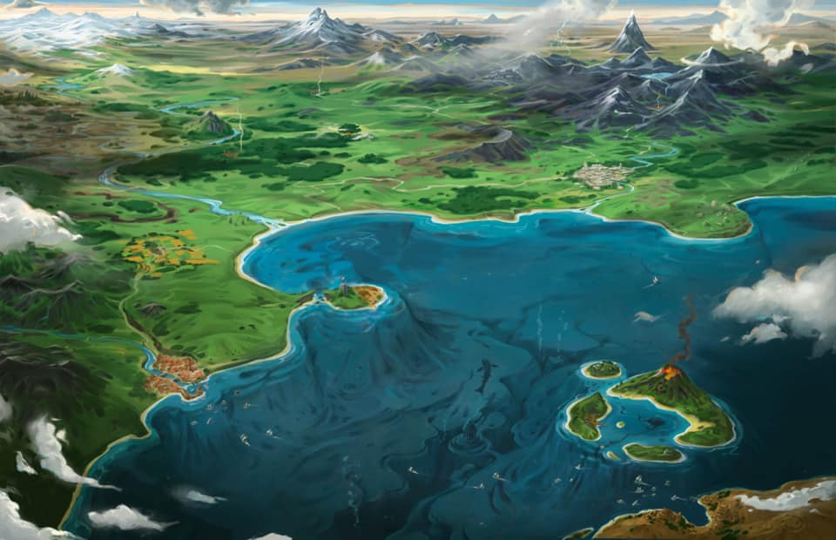
Ankhapur
Saelmur
keep
site
Thistlewood
Docks
Mintar

Slide 5
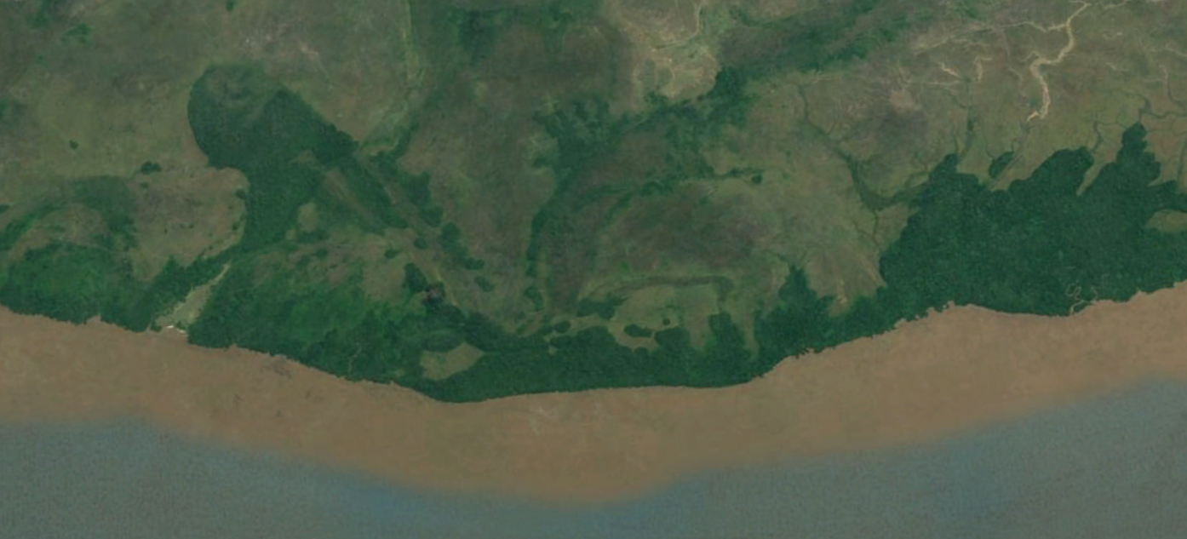

Slide 6
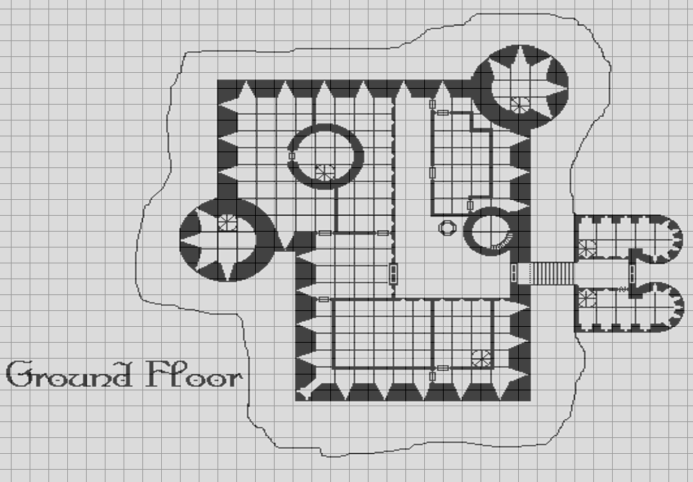
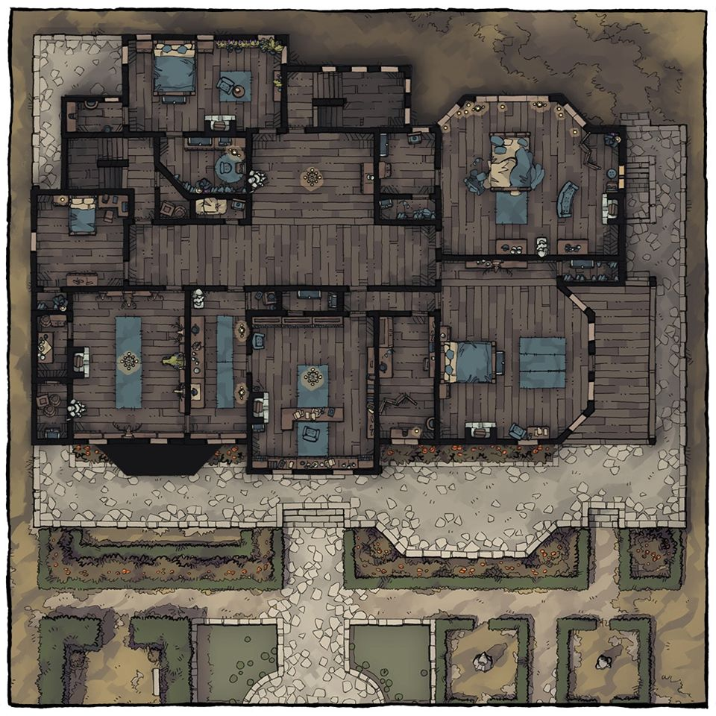
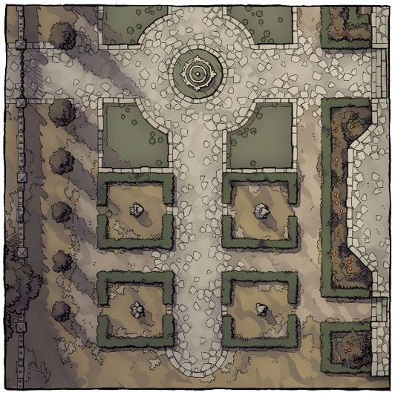
Baron’s Keep
s
E
w
L
G
s
B
Southspur

Slide 7
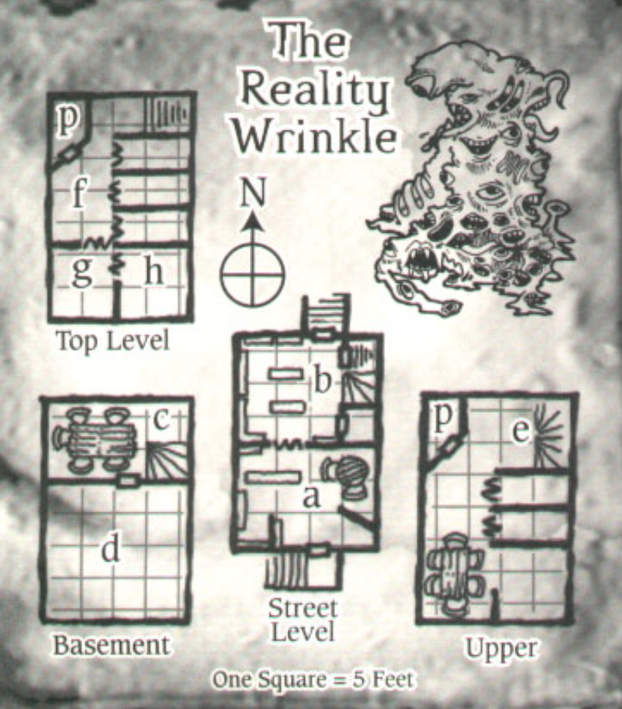

Slide 8
