Slide 1
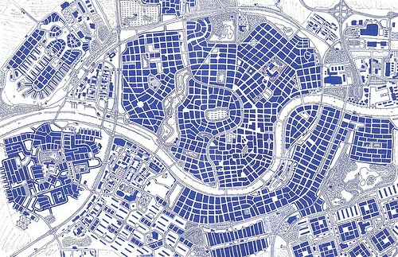

Port Loren, Gran Quivera
(under
construction)
Lorentine Bay
To Vrid’ch’k District
Lorentine
Zoo
LaLa Land
Theme Park
Fortress
Campus
FF&S
Krav
Sisterhood
Haven
E&F
Northwestern
Gated
Community
Prospective
Hivemind HQ
OurTime
Senior
Living
Spaceport
Loren
Art Studios
Tourist
Trap
Central
Lorentine
Mall
Grassland
Park
Speakeasy
Site 1
Showdown
Heights
Monorail Office
PoLo
Safehouse
Legal
Offices
To Beaches
FF&S
Autonomic
Small
Business
Complex
Hotels and
Restaurants
Low-income
Housing
Shogun’s
Palace
Old Town
Suburbs
Fromeltar
Estuary
Aircar
Central
Condos
Speakeasy
Site 2
Hi-Tech
Sector
New Housing
Development
Dormitories
Ranches
&
Workshops
AAL
Safehouse
Local
Freight
University of
Gran Quivera
To Beaches

Slide 3
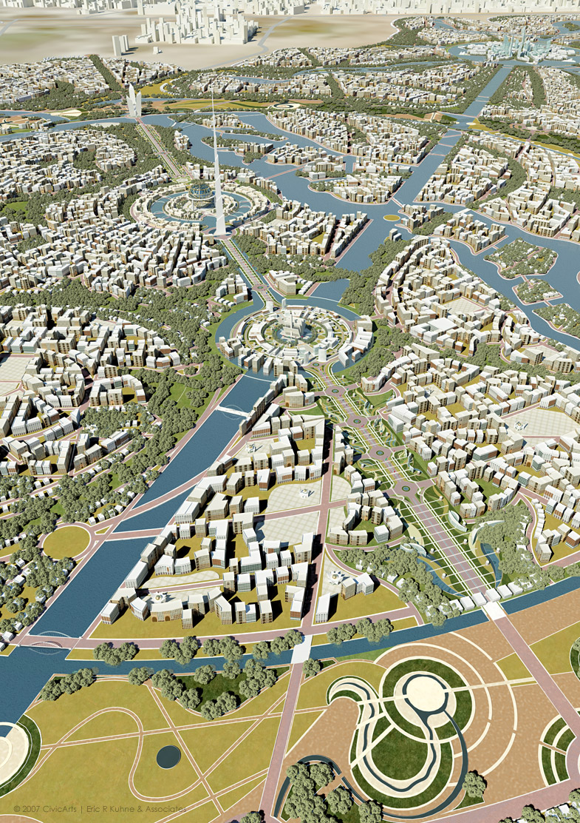

Slide 4
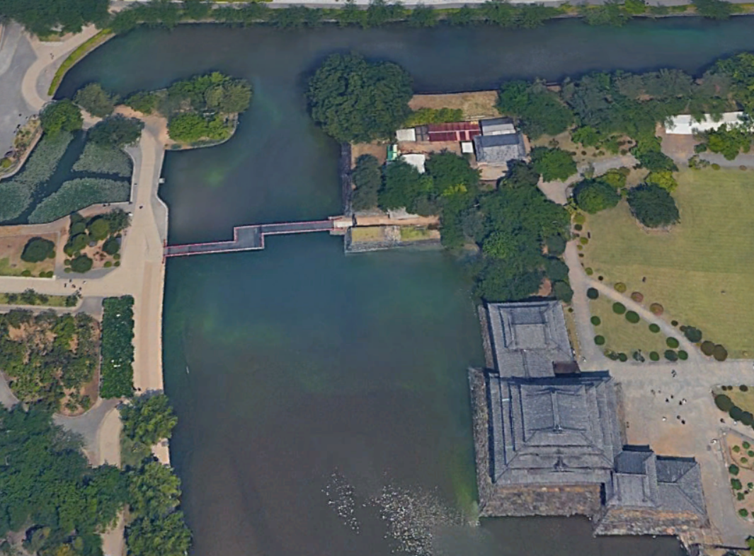
Personnel
Carrier
Police
Cruiser

Slide 5
