Slide 1
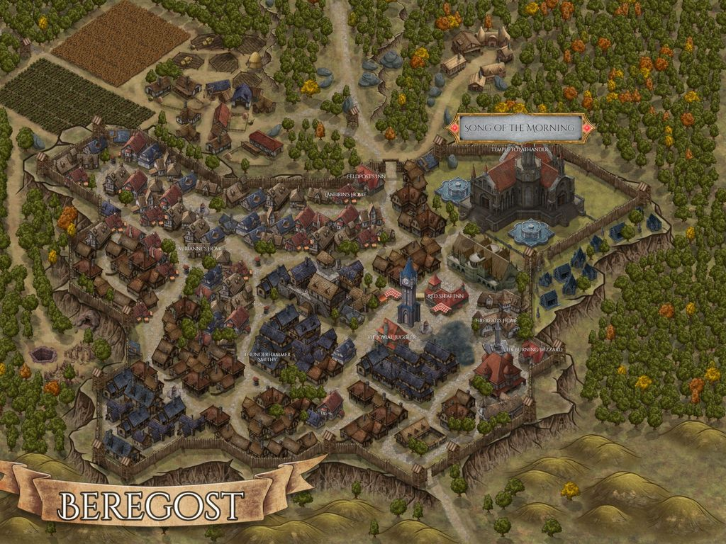

Beheaded Beholder

